Slide 1
SY 2020-21 Annual Title I Meeting
River Hall Elementary September 23, 2020 5:00PM
School Media Center/Zoom
Jody Poulakis, Principal

Slide 2
Why are we here?
The new Every Student Succeeds Act (ESSA) of 2015 requires that each Title I School hold an Annual Meeting of Title I parents for the purposes of…
Informing you of your school’s participation in Title I
Explaining the requirements of Title I
Explaining your rights as parents to be involved

Slide 3
What does it mean to be a Title I School?
Being a Title I School means receiving federal funding (Title I dollars) to supplement the school’s existing program.
Identifying students experiencing academic difficulties and providing timely assistance to help these students meet the state’s challenging content standards
Funding supplemental staff, programs, materials, and supplies: Additional Dean of Students and 4 additional resource teachers

Slide 4
Title I Funding
Receives approximately $565,000
ESSA maintains current Title I funding formula
Based upon poverty census data
School ranking based upon percent needy report
Currently, there are 45 Title I schools in The School District of Lee County

Slide 5
River Hall Elementary How are the funds spent?
Additional Personnel:
Peer Collaborative Teacher, 3 resource teachers, 2 Para
Pros, 1 Parent Involvement Para, 1 Clerk Typist
Supplies and Materials
After-School Tutoring Program
Professional Development & Training for Teachers & Staff

Slide 6
Curriculum - What is your child learning and how are they being assessed
Reading Curriculum: Really Great Reading, Reading Street K-3, Ready Gen 4/5, Math: Go Math K-5, Science McGraw Hill
What assessments are expected to be administered this year and approximate dates?
Assessments include BOY (September), MOY (January), EOY (May) iReady, STAR Early Literacy (Kinder) and ongoing formative assessments in class
What interventions do we provide to struggling students?
WIN Time is built around the standards that students need to master providing both intervention and enrichment to individual students.

Slide 7
What’s included in the school’s Parent and Family Engagement Plan?
How parents/families can be involved in decision-making and activities
School Advisory Council (SAC), PTO, Conferences, Volunteering, etc
How family engagement funds are being used
Para-Pro, supplies & materials for family events
How information and training will be provided to parents/families
Monthly family events are planned
How the school will build capacity in parents/families and staff for strong family engagement
Monthly newsletters with academic and social-emotional supports

Slide 8
How can parents be involved?
Participate in the development of the Home/School Compact
Participate in the development of the school’s Parent Involvement Policy
Participate in the development of the School Improvement Plan
Participate in planning the parent involvement program and activities
Participate in parent workshops at the school
Become a parent volunteer

Slide 9
What is the School-Parent Compact?
The compact is a commitment from the school, the parent, and the student to share in the responsibility for improved academic achievement.
You, as Title I Parents, have the right to be involved in the development of the School-Parent Compact
These compacts are developed with input from ALL stakeholders and are then signed by the teacher, parent, and the child

Slide 10
How do I request the qualifications of my child’s teachers?
With ESSA, teachers MUST follow the licensure and certification requirements set by the State of Florida.
You, as Title I Parents, have the right to request the qualifications of your child’s teachers and paras
This information can be obtained by speaking with the school’s Principal Jody Poulakis or Assistant Principal Michelle Mell
Parents are notified via a letter if/when their child is taught by a non-licensed, non-certified teacher for four consecutive weeks

Slide 11
River Hall Elementary FY 21 Achievement Goals
Our School’s Mission Statement: To provide a safe, secure environment that ensures the development of the whole child.
MOTTO: “Where Children Think They Can and They Do”
Our School’s Goal for 2020-21
ELA % Proficient: From 44% to 52% LG: From 46% to 55%, L25 LG From 45% to 56%
3rd Grade 50%; 4th Grade % 52%; 5th Grade 55%
Math % Proficient: From 45% to 51% LG: From 53% to 66%, L25 LG From 43% to 53%
3rd Grade 51%; 4th Grade 53%; 5th Grade 52%
Science % Proficient: From 44% to 55%
Total School Grade Points GOAL: 388 out of 700 “B”

Slide 12
Title I Annual Meeting Parent Survey
Please complete the 2020-2021 Title I Annual Meeting Parent Survey in order to assist with the implementation of a Title I Schoolwide Program that meets the needs of your family. (Spring 2021)
The results of this survey will be utilized to help in the development of the Title I School-level Parent and Family Engagement Plan (PFEP), and future parent and family engagement activities, events, and workshops.

Slide 13
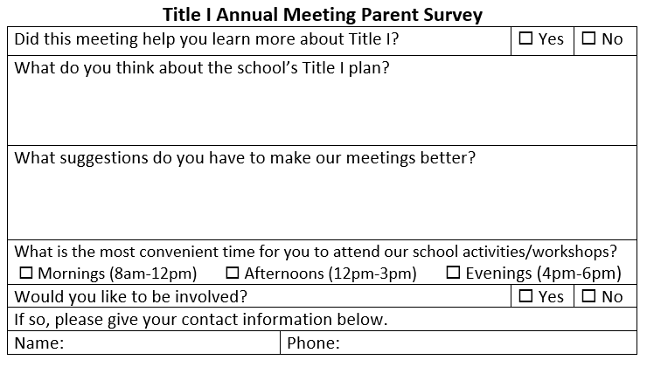
Title I Annual Meeting Parent Survey
Click the link to the Google Survey https://forms.gle/vBDJs2fHCQqDXU8B8
Haga clic en el enlace a la encuesta de Google. https://forms.gle/ZHTgQ5B7xgTa9toL9
Klike sou lyen ki mennen nan Sondaj Google
https://forms.gle/Weo16E5yK77htMU5A
Notes:
[Distribute survey in multiple languages and collect. Inform parents that the completed survey will be collected at the end of the meeting or by the classroom teacher. All completed surveys should be returned to the parent involvement contact]
[The PI contact will complete Compilation of Survey results using template from Title I SharePoint Site.]

Slide 14
Your Involvement is Key to Your Child’s Success!
You are your child’s first teacher
You have the ability to influence your child’s education more than any teacher or school
You know your child best:
Share information about your child’s interests and abilities with teachers; and
Ask to see progress reports on your child or access via the Parent Portal to view information about your child’s academic progress

Slide 15
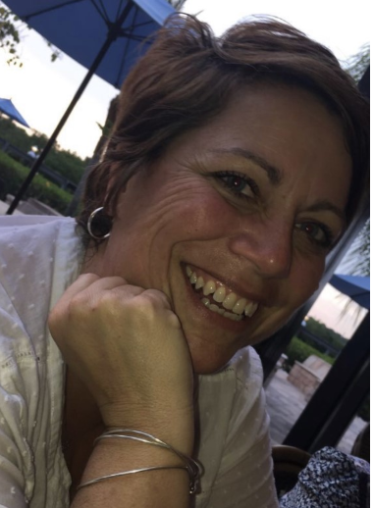
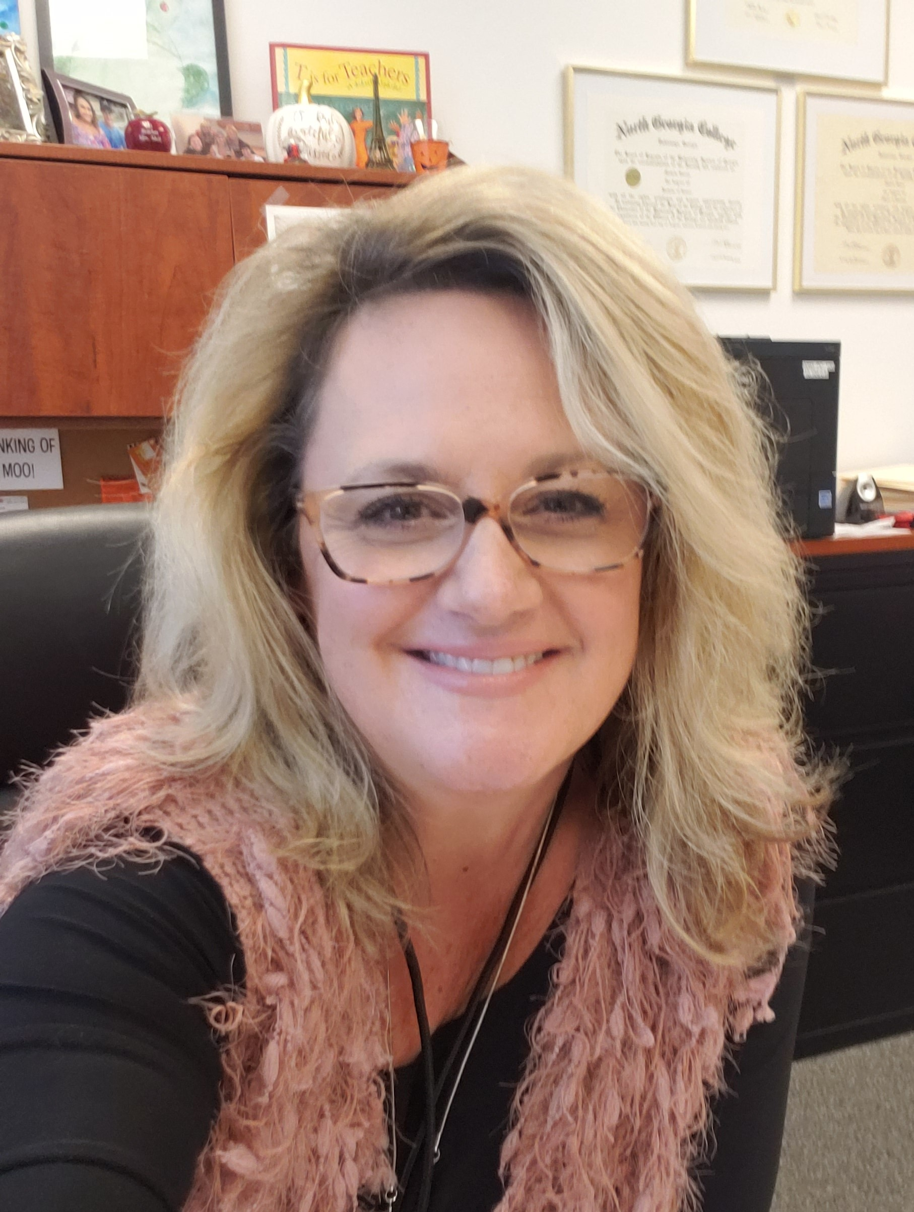
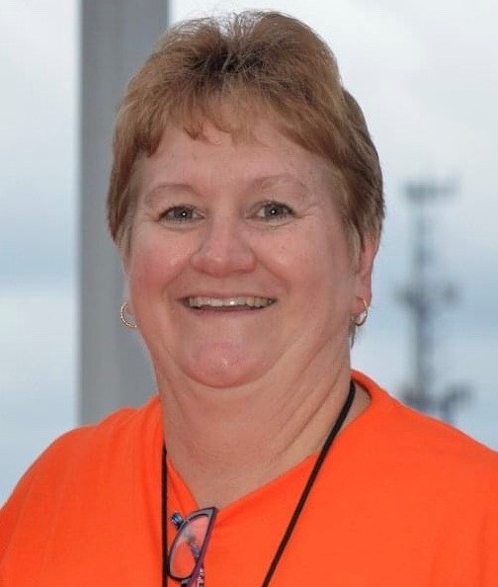
School Contact Information
Jody Poulakis
Principal
Michelle Mell
Assistant Principal
Becky Van Helden
Parent Involvement Specialist

Slide 16
Questions?
Thank You for Attending!

